Slide 2

Rapid prototyping of genetic logic gates
Christelle Al-Jamous , Nessim Louafi
Supervisors: Ana Zuniga, Pauline Mayonove, Paul Saudier, Jerome Bonnet
24/05/2022

Slide 3
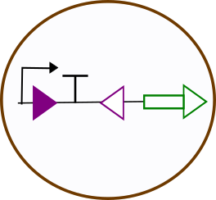
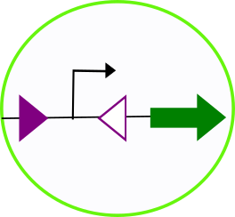
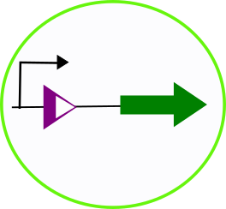
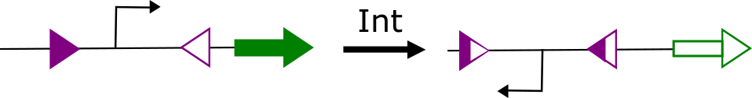
What are logic gates?
ID
NOT
OFF
ON
Integrase
Integrase
ON
OFF
Introduction

Slide 4
Principal goals of the Lab1:
Can we rapidly prototype logic gates?
Can we use cell-free?
flow cytometry
cell-free
Can we predict in cellulo response?
Introduction

Slide 5
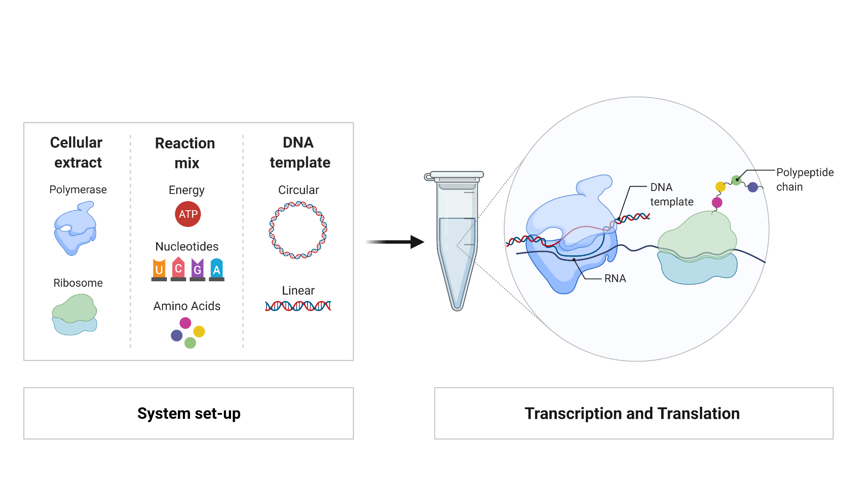
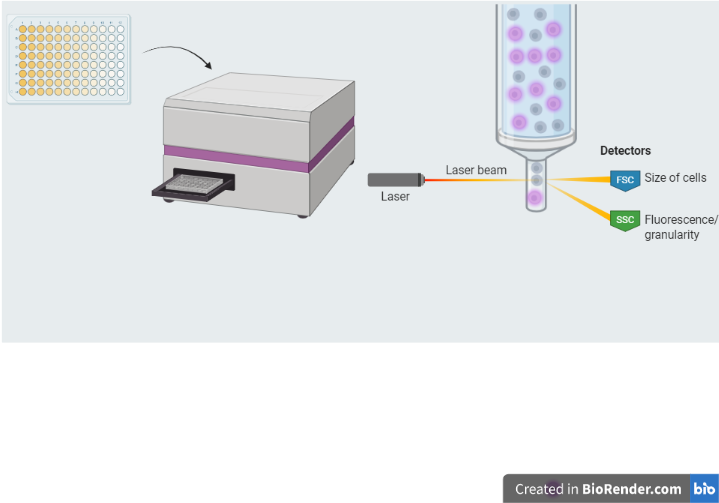

Introduction : the different techniques used
Plate reader
flow cytometry
Introduction

Slide 6
Plan
Adding layers of complexity to the sequence
Possible link between in-vivo in-vitro?
Modelling to find another metric?
Conclusion
Introduction
Proof of concept

Slide 7

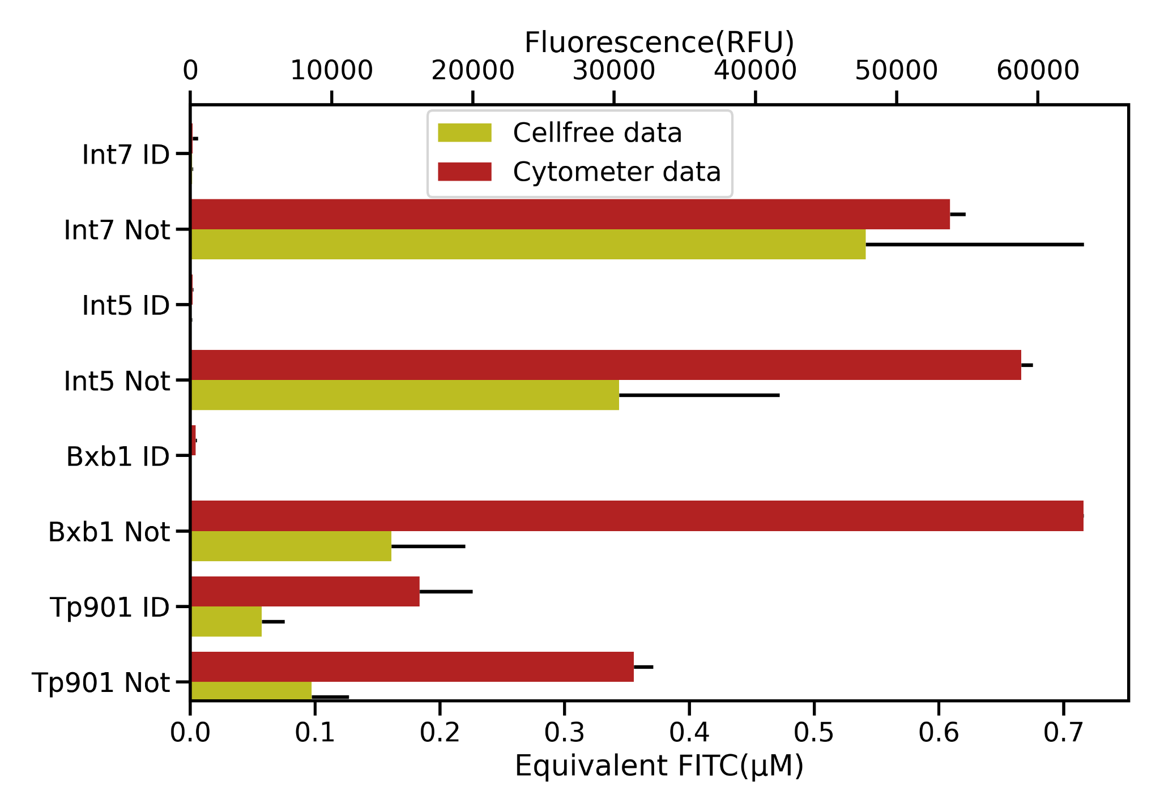
Proof of concept: Does cell free results match in cellulo results?
n = 1 in triplicates
General trend is conserved
We can use cell-free to study logic gates
Integrase : Logic element
Proof of concept

Slide 8
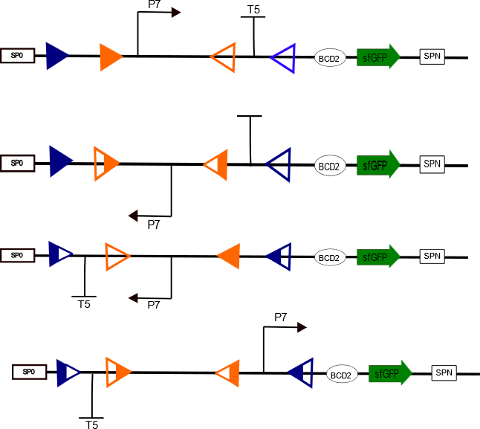
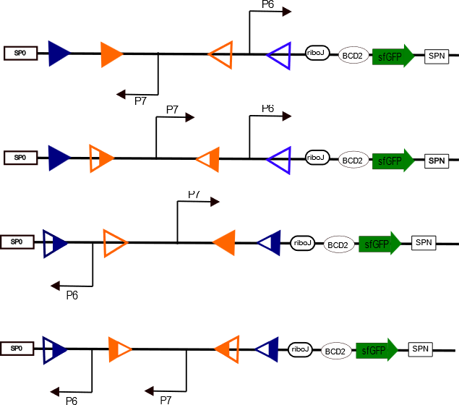
Testing more complex constructs: towards the limits of the system
AND
NAND
Output (expected)
0
0
0
1
Output (expected)
1
1
1
0
Adding layers of complexity

Slide 9
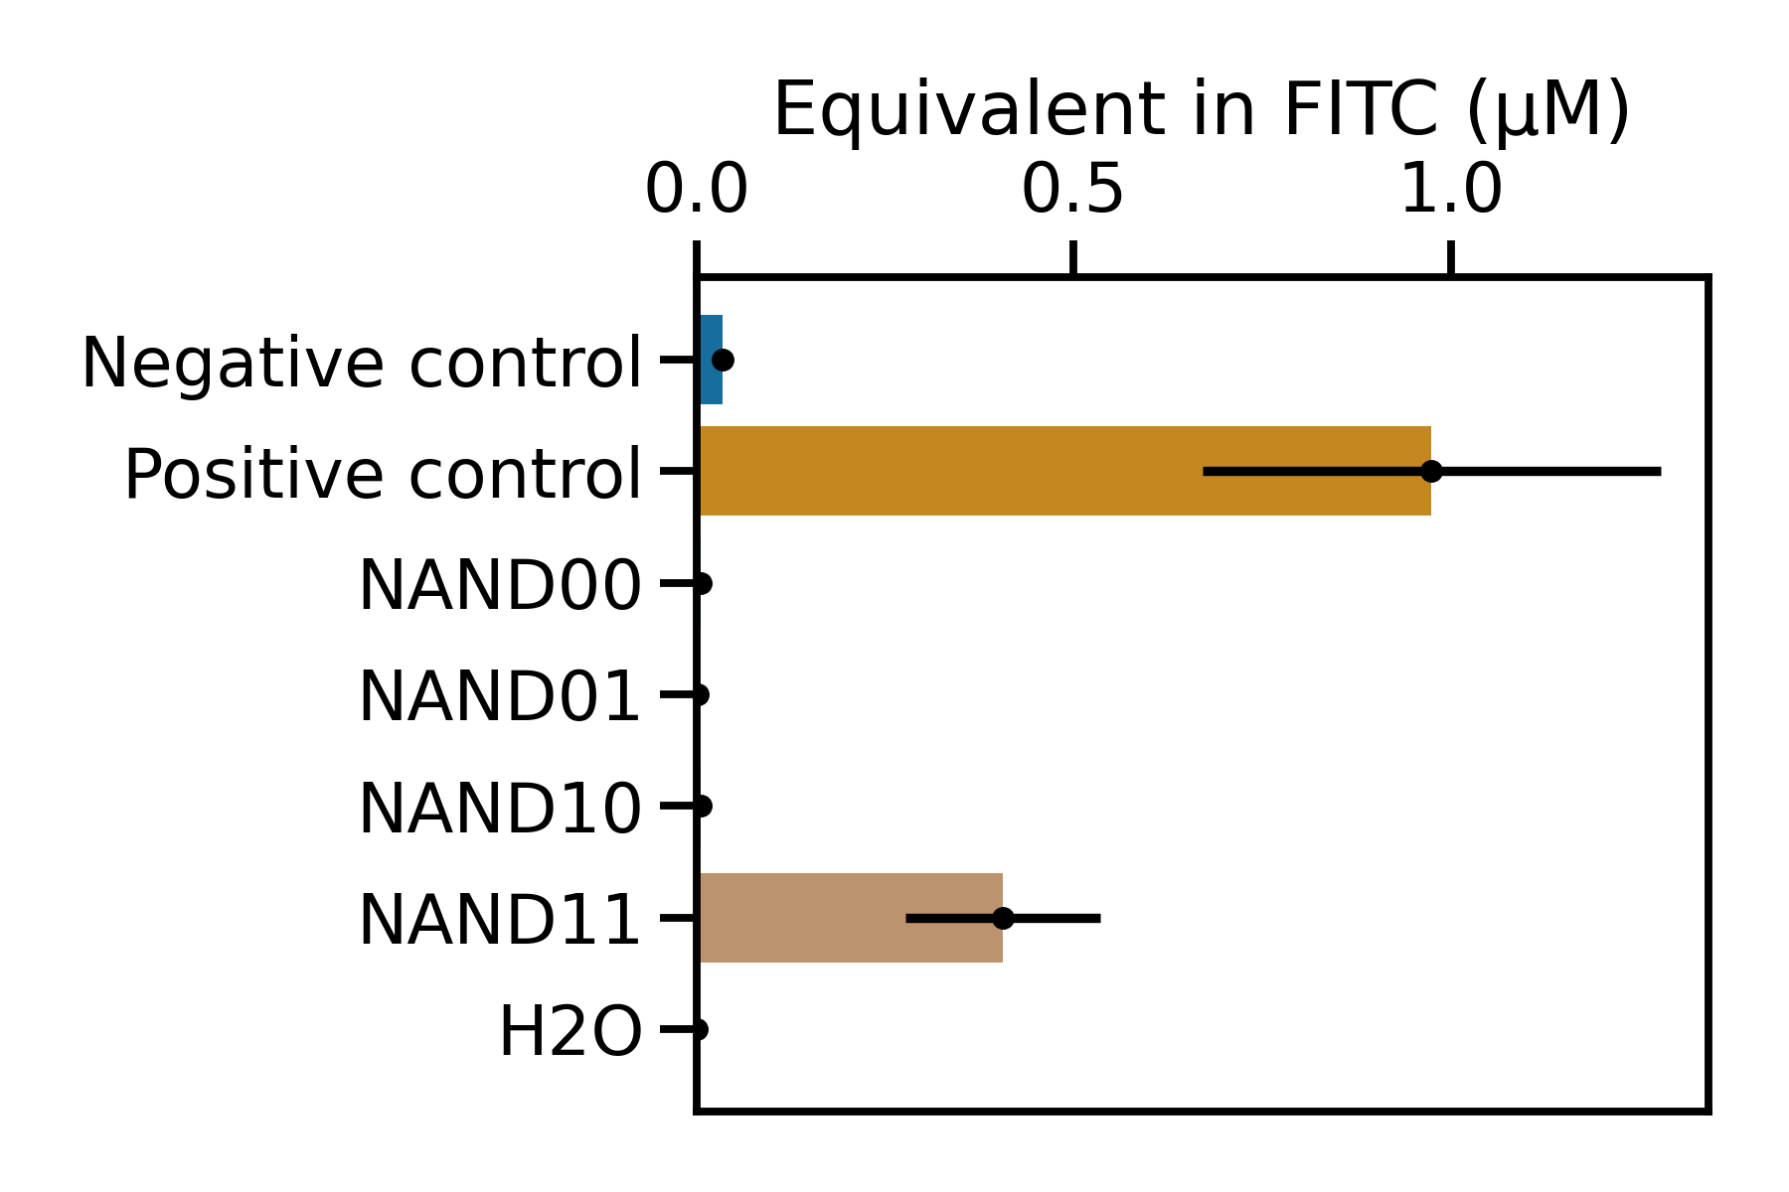
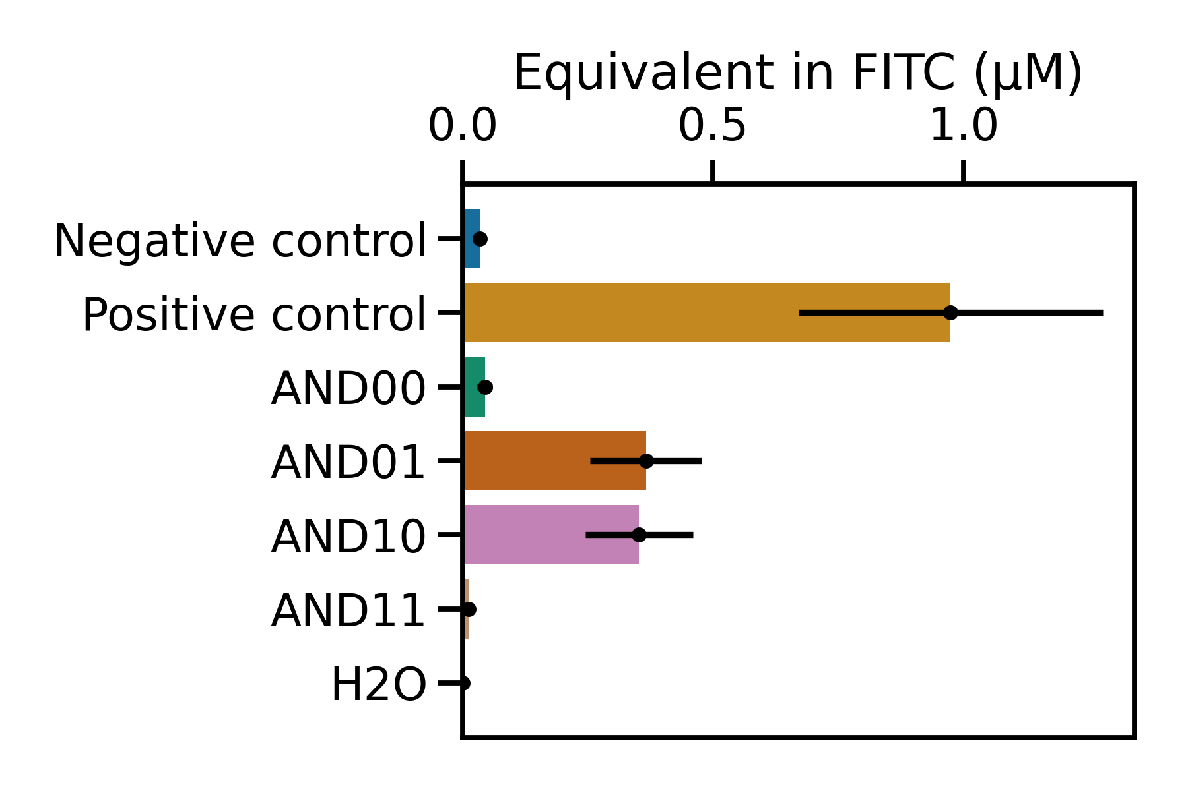
Testing more complex constructs: towards the limits of the system
n = 1 in triplicates
AND
NAND
OUTPUT
OUTPUT
*
0
0
0
1
1
1
1
0
* : Unexpected result
Adding layers of complexity
Notes:
AND NAND

Slide 10
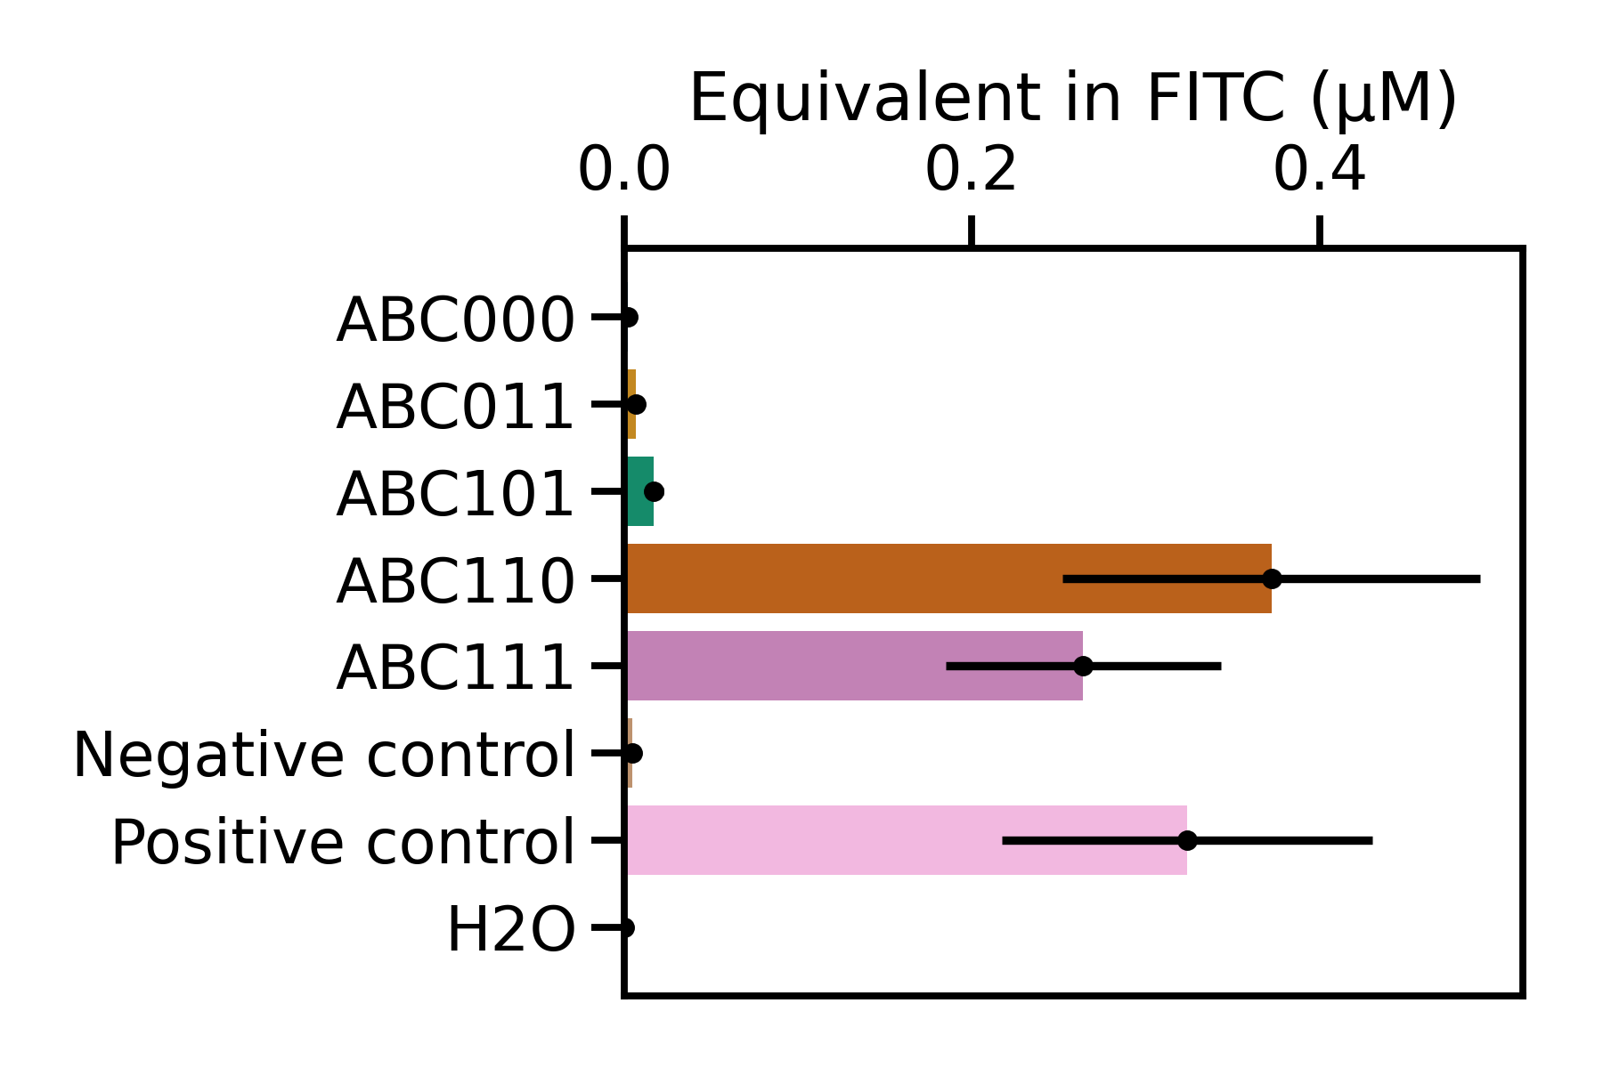
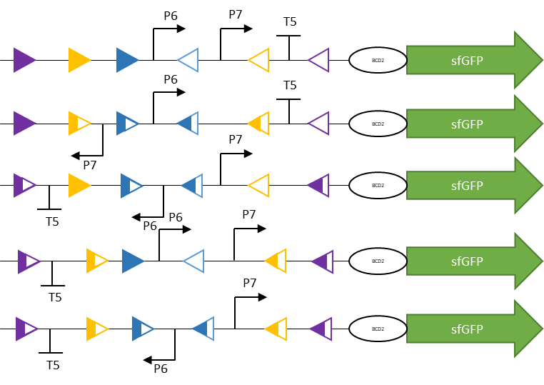
Limits of the system : 3 inputs
n = 2 in triplicates
Output (expected)
0
0
1
1
1
*
* : Unexpected result
Adding layers of complexity

Slide 11
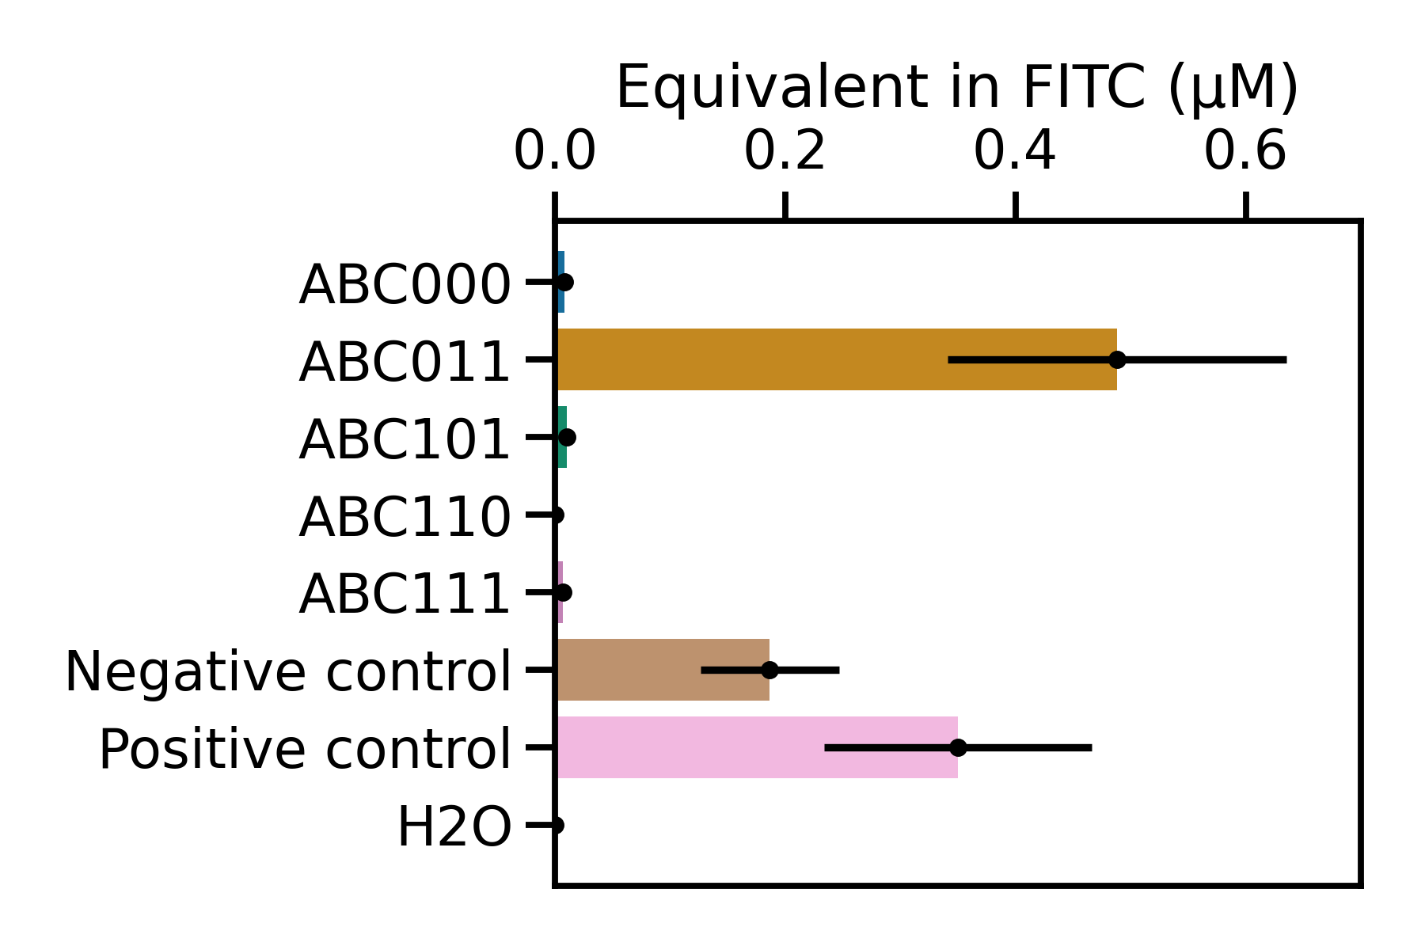
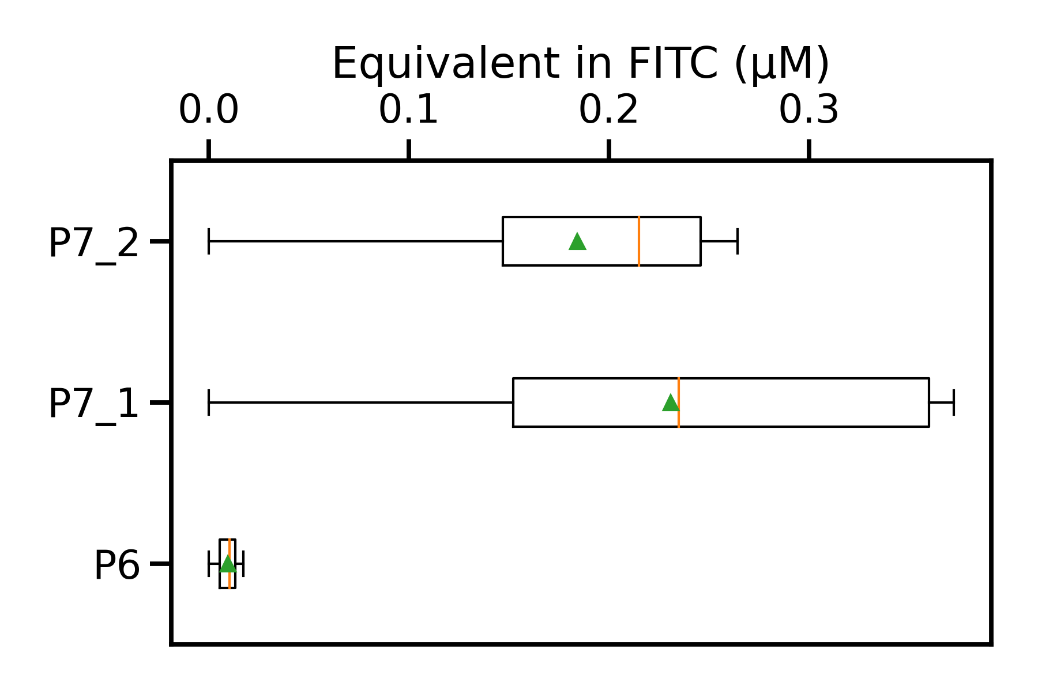

Explanation for the limit: two different issues
P6 being a weak promoter
Sequence gets too complex
First experiment with 3 integrases
Output (expected)
0
0
1
1
1
Adding layers of complexity
Notes:
#e7e6e6

Slide 12
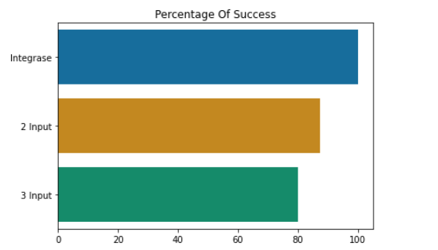
Conclusion on the complexity of the sequence
Percentage of success(%)
Adding layers of complexity

Slide 13
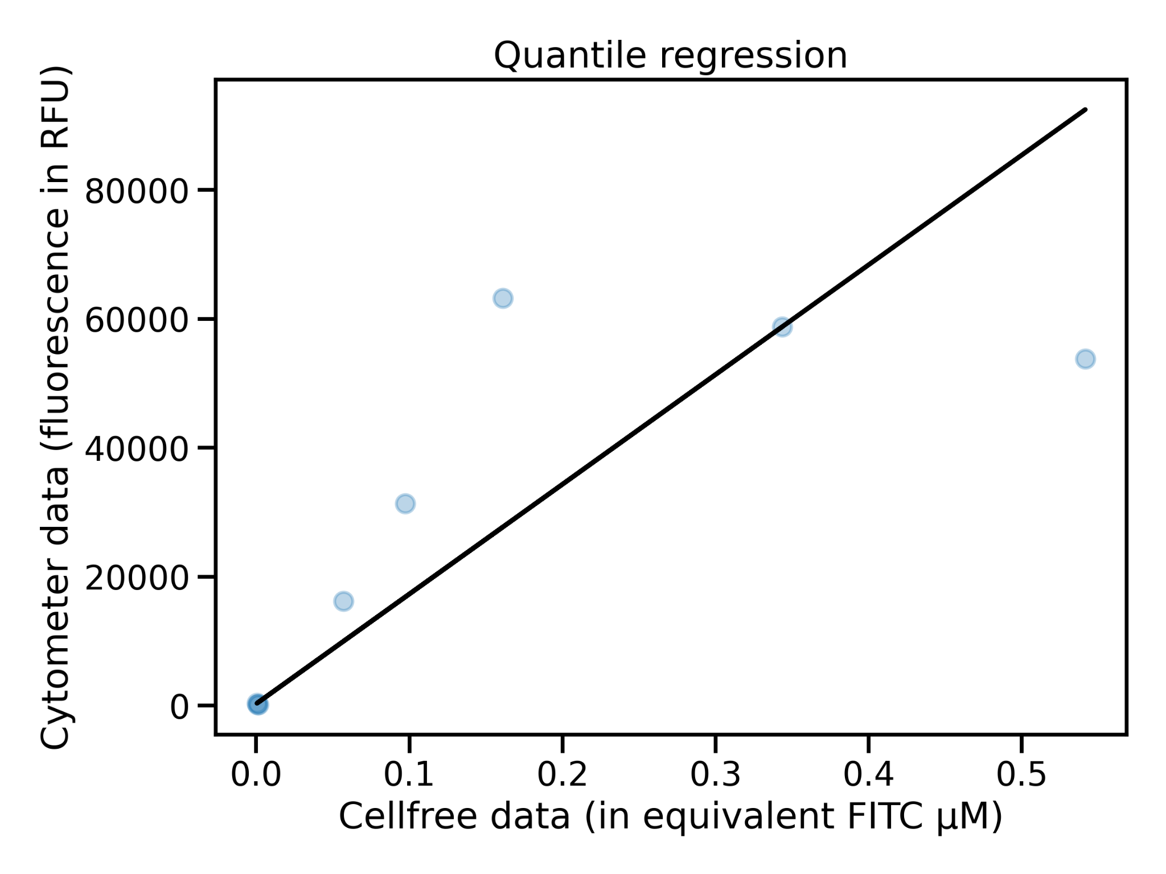
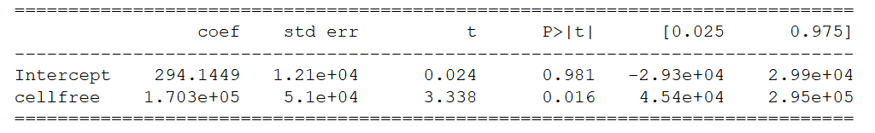
Can we predict in cellulo response from cell free?
Linear regression
Correlation is significative but probably not real
Correlation cyto/CF
Notes:
a refaire ?

Slide 14
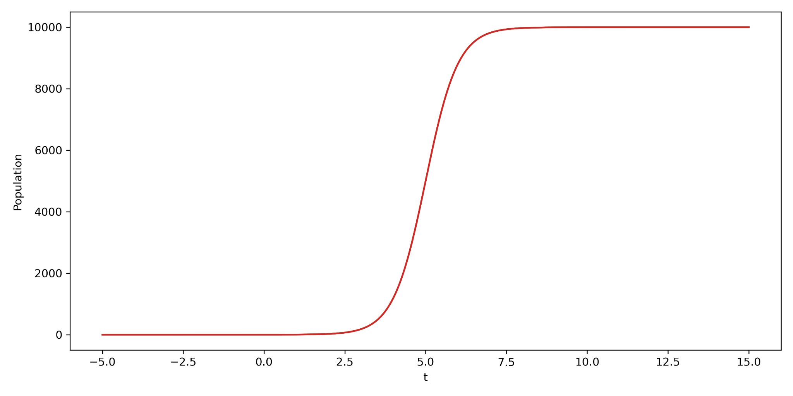
Going further in the correlation
Acquire more data points
Multiple options
In cellulo prediction
Trend observed is conserved
Trend observed was not significant
It will produce
Try again with more robust regression
It won’t produce
Observed production in cell-free
Correlation cyto/CF

Slide 15
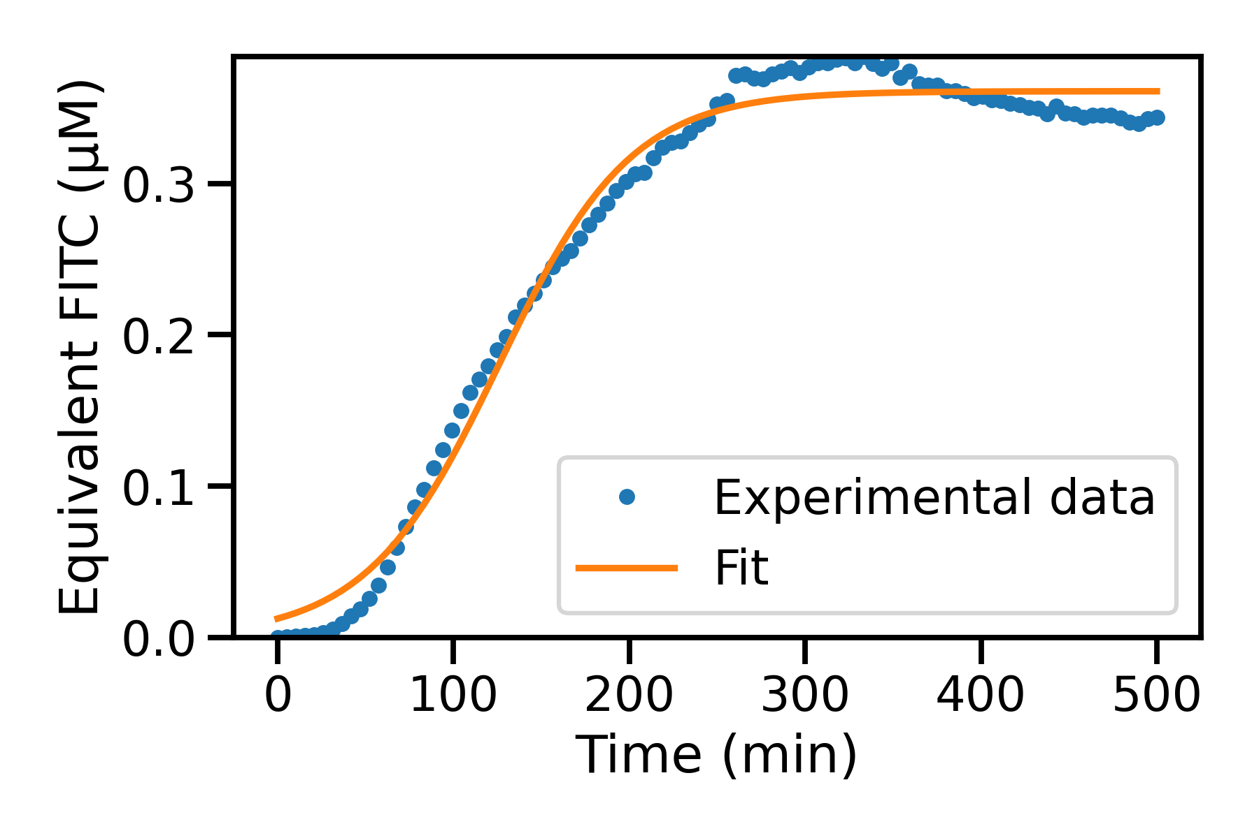
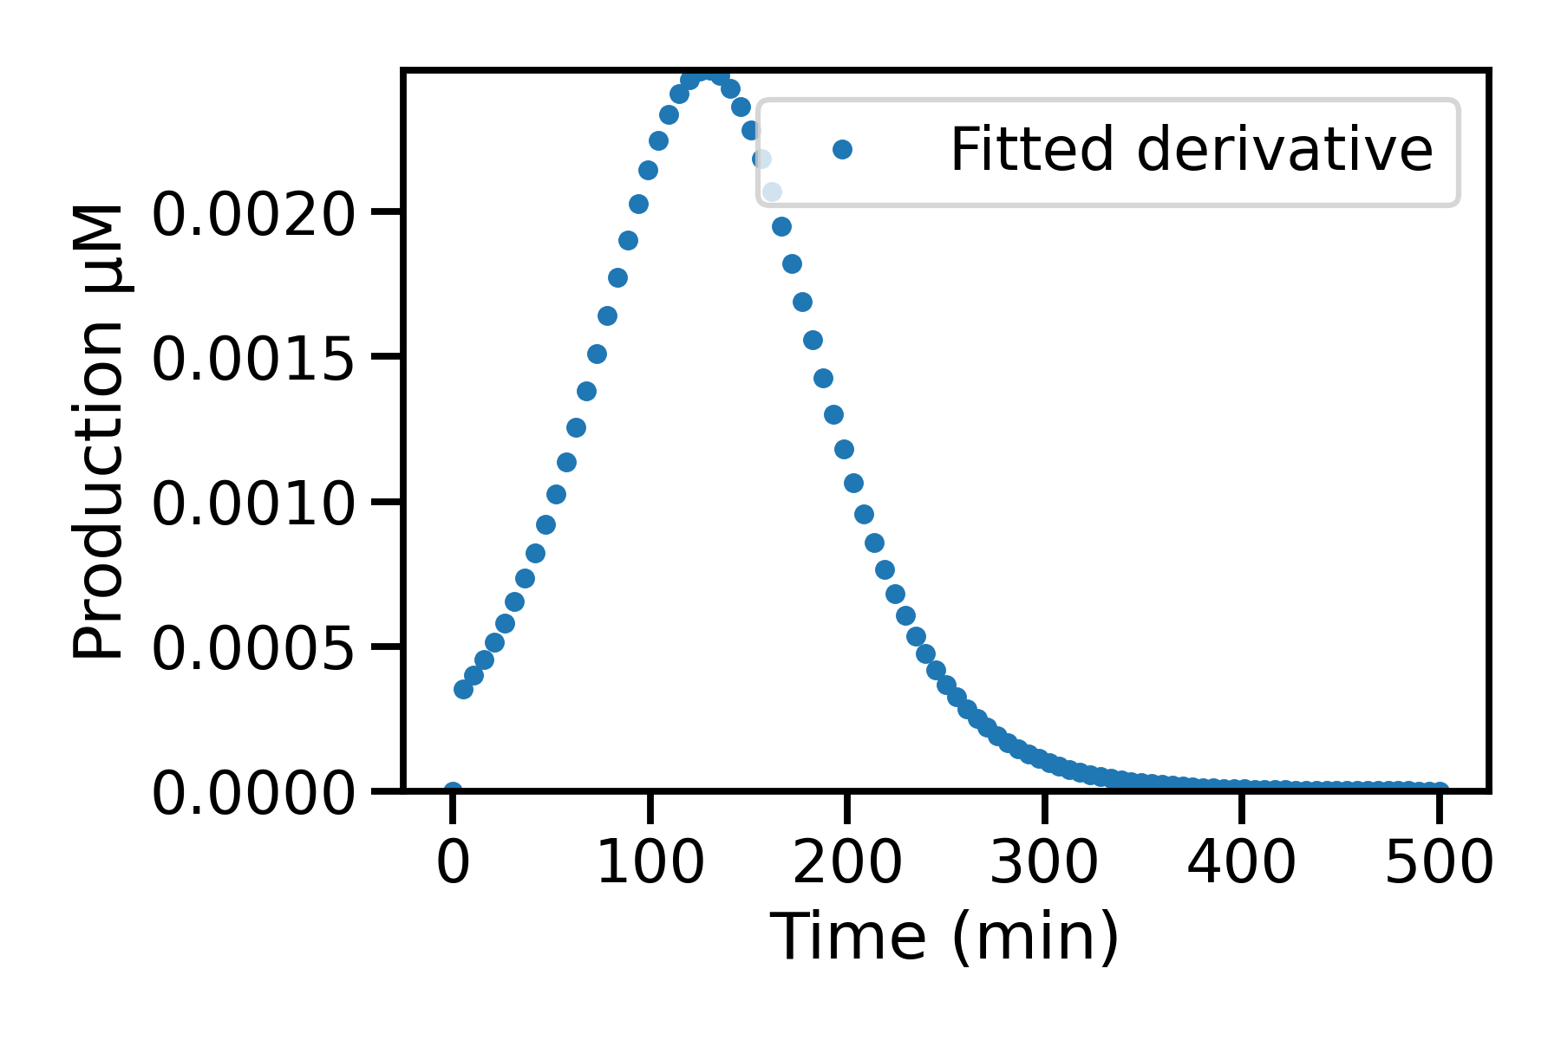
Can we add other metrics using modeling?
We have : [GFP](t)
Take the derivative with respect to time
d[GFP]/dt
Production rate over time
Time at maximum production rate
Modelling

Slide 16
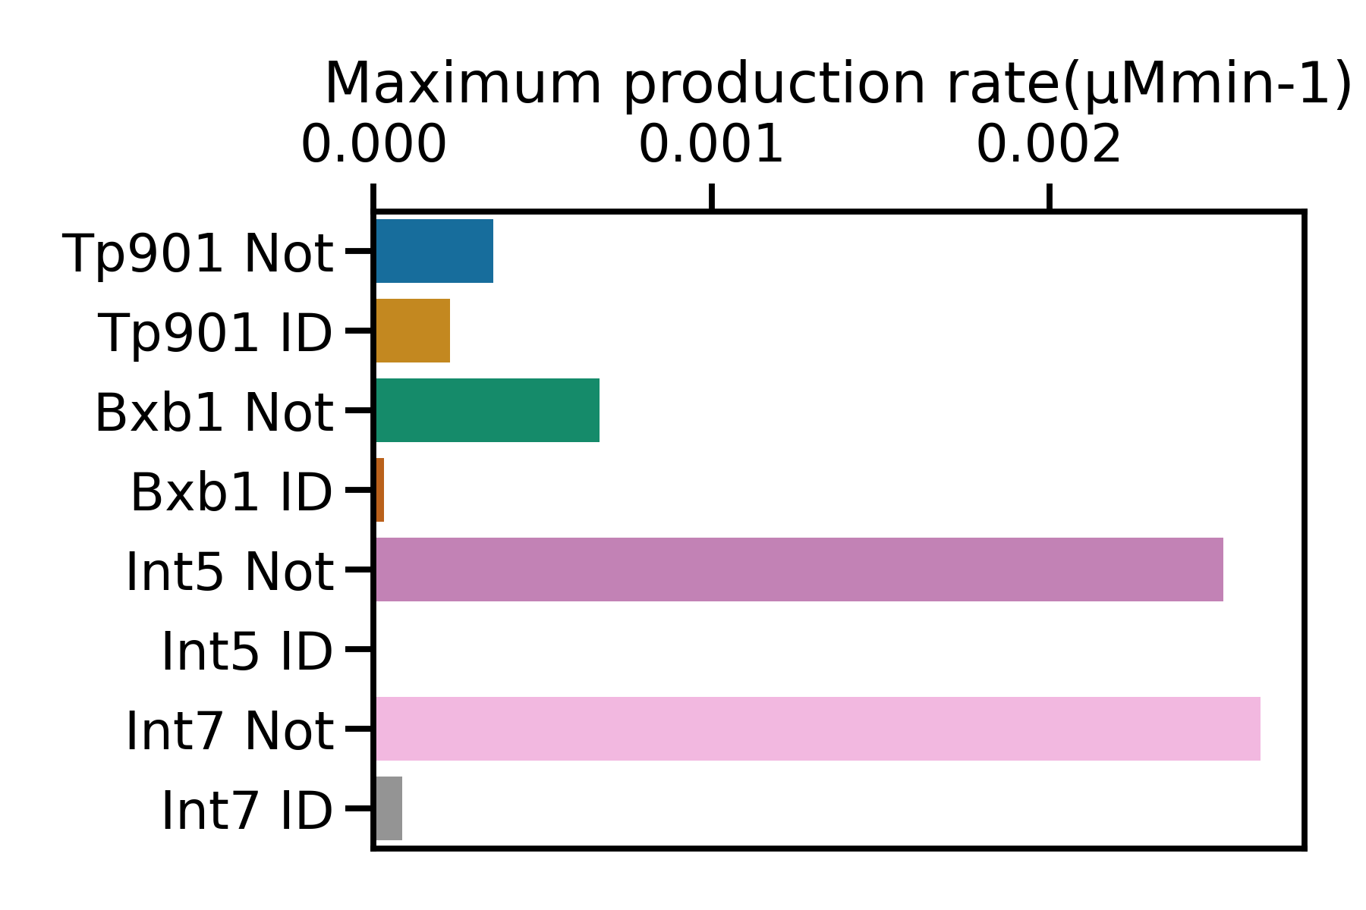
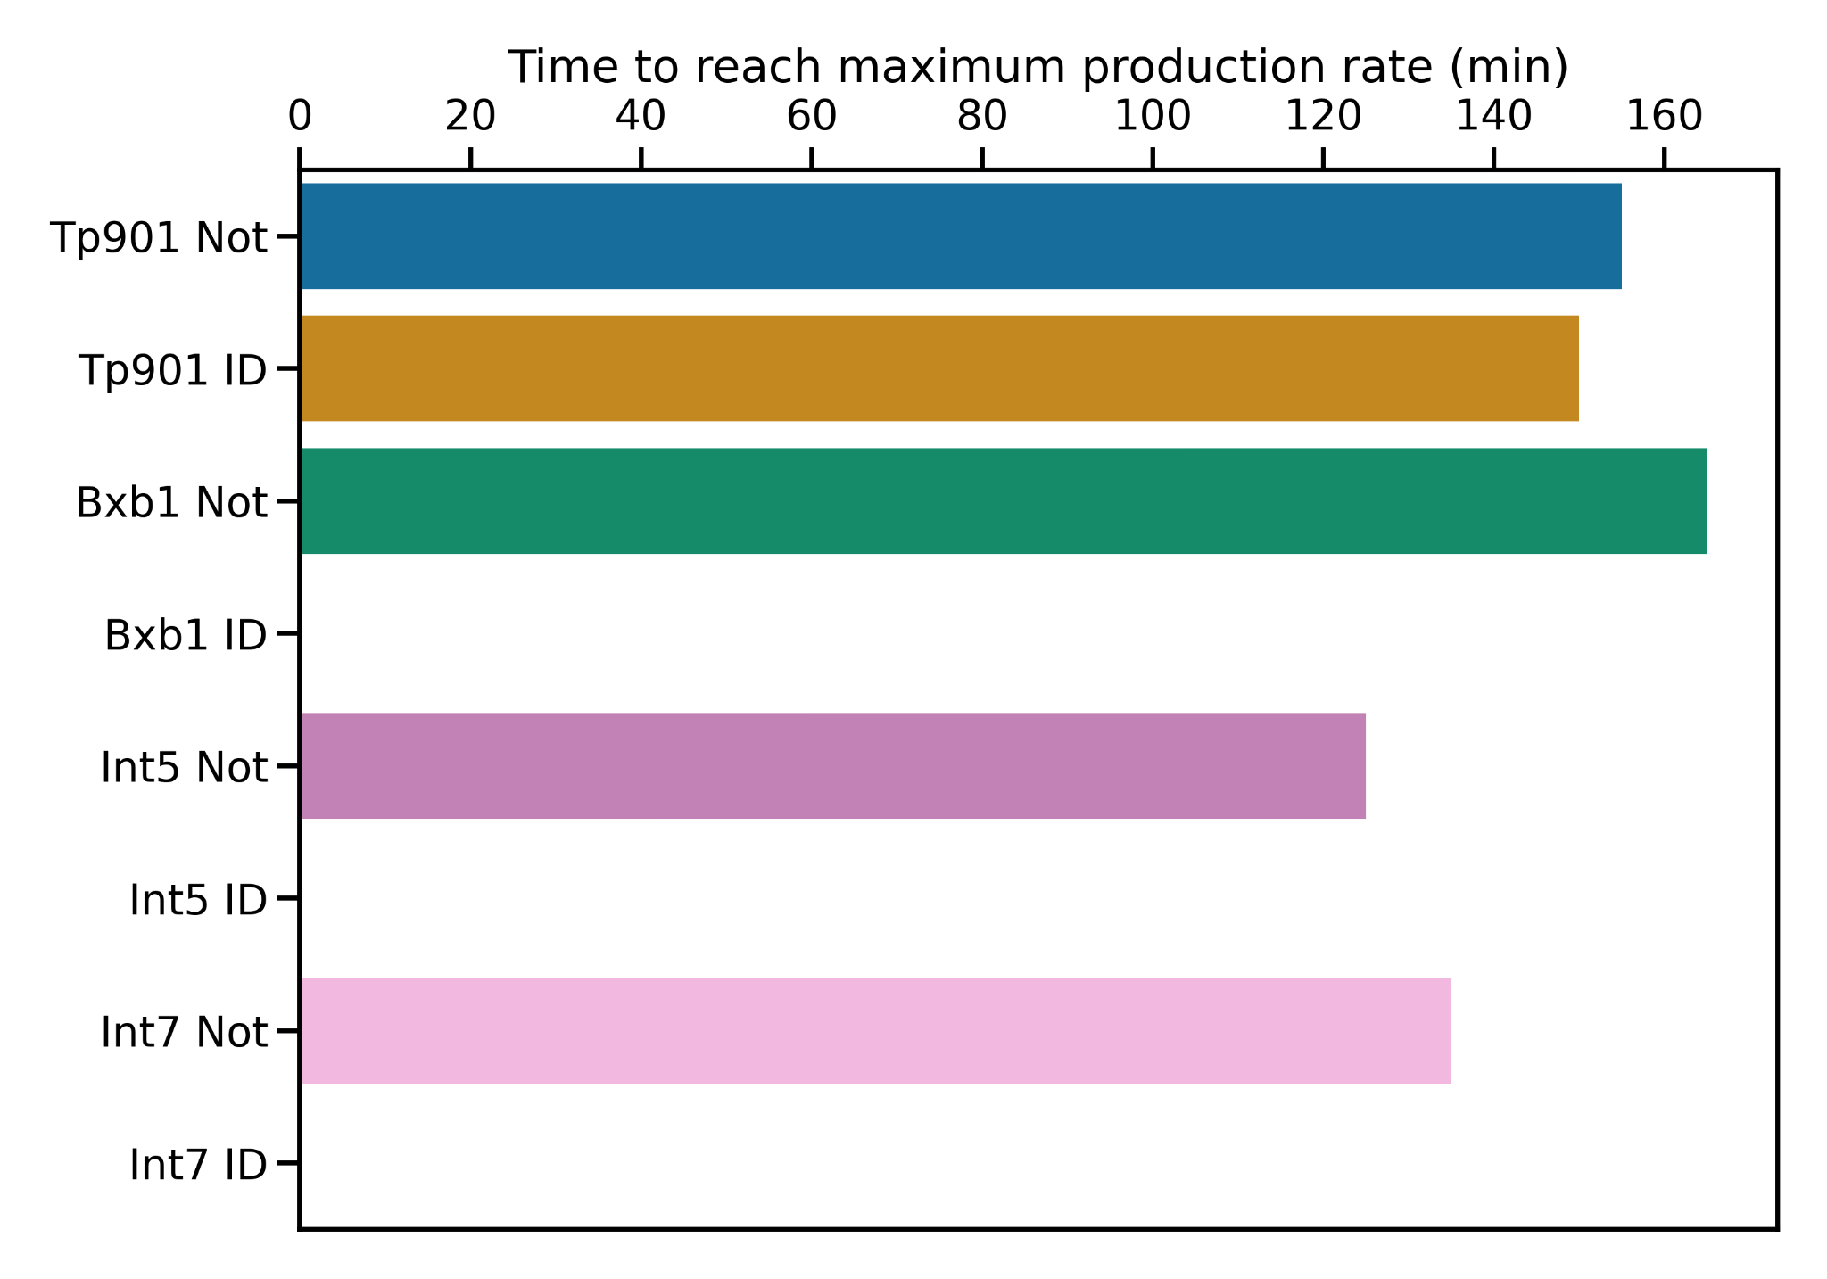
Two new metrics
Production rate
Time at which the production is maximum
Information on the kinetics and not only total production
Modelling

Slide 17
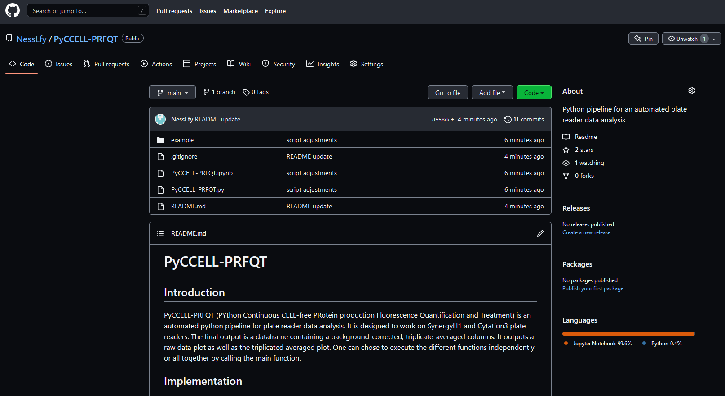
Development of automated data analysis
PYthon Continuous CELL-free PRotein production Fluorescence Quantification:
PyCELL-PRFQT
Modelling

Slide 18
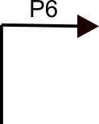
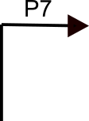
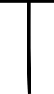



Conclusion
Can we rapidly prototype logic gates in cell-free?
strength of the promoter/ terminator
complexity of the sequence
choice of the integrases
Conclusion
Notes:
add the

Slide 20
Adding layers of complexity

Slide 21
Proof of concept

Slide 22
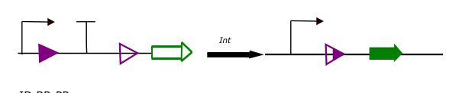
Boolean logic in biology : logic gates
Technique to control the function of a cell
NOT ELEMENT
ID ELEMENT
Inversion of the promoter
Excision of terminator
GFP production is stopped
GFP production
Figures adapted from (S.Guiziou et al, nature communication 2019)
Introduction
Notes:
talk about integrase

Slide 23
Going further in the correlation
Multiple options
Assume outlier is “real”
Assume outlier is not real
In any case more data is needed to confirm observation
Use a more robust regression (that accounts for outliers)
Remove point and recalculate regression
Try to fit the data with another regression (non-linear)
Correlation cyto/CF

Slide 24
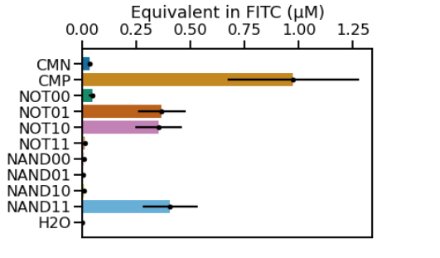
Testing more complex constructs: towards the limits of the system
n = 1 in triplicates
Integrase 1
Integrase 2
OUTPUT
0 | 0 | 1
0 | 1 | 1
1 | 0 | 1
1 | 1 | 0
*
Integrase 1
Integrase 2
OUTPUT
0 | 0 | 0
0 | 1 | 0
1 | 0 | 0
1 | 1 | 1
CMP: Positive control
CMN: Negative control
* : Unexpected result
Adding layers of complexity
Notes:
AND NAND

Slide 25
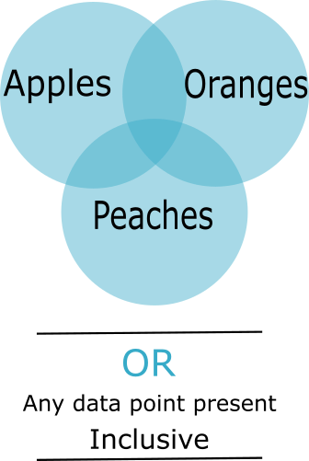
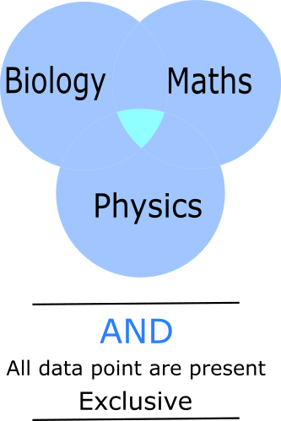
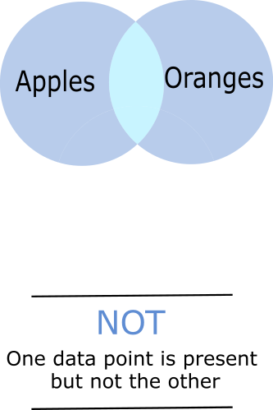
Boolean logic
A | B | A OR B
0 | 0 | 0
0 | 1 | 1
1 | 0 | 1
1 | 1 | 1
A | B | A AND B
0 | 0 | 0
0 | 1 | 0
1 | 0 | 0
1 | 1 | 1
A | B | A NOT B
0 | 0 | 1
0 | 1 | 1
1 | 0 | 1
1 | 1 | 0

Slide 26
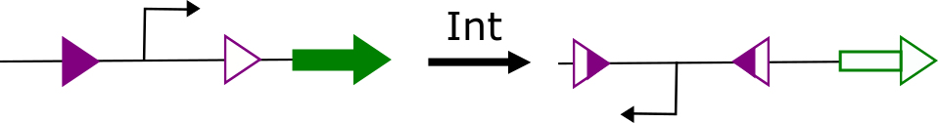
Excision of terminator
Excision of promotor
GFP production is stopped
GFP production

Slide 27
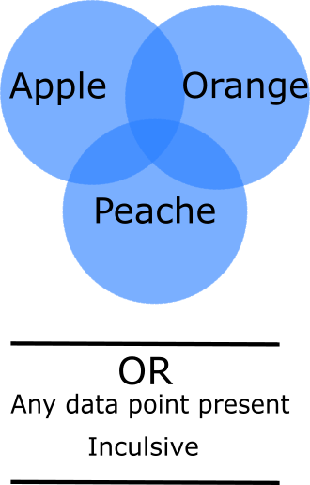
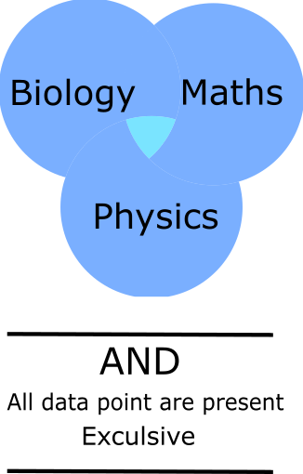
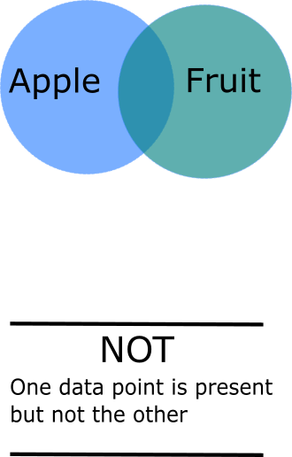
boolean logic

Slide 29
Discussion

Slide 30
Can we rapidly prototype logic gate design using cell free
YES
NO
Discussion

Slide 31
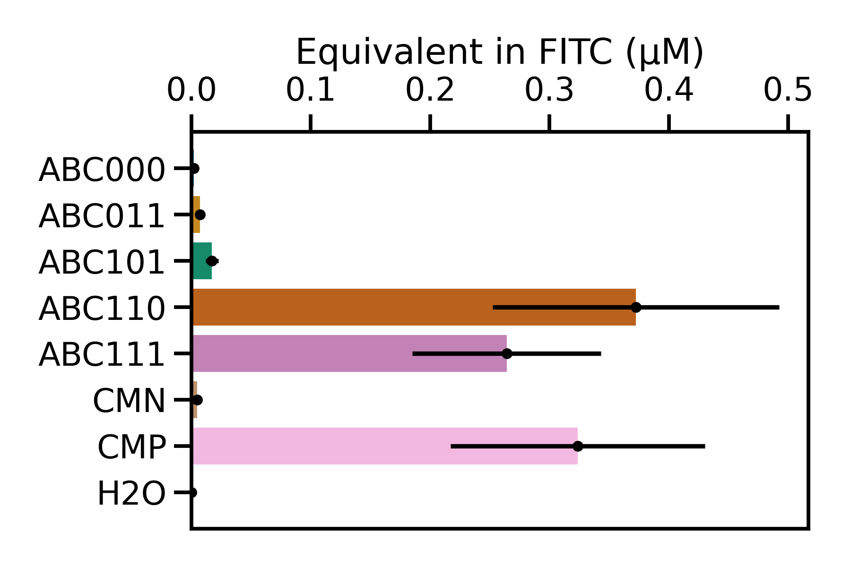
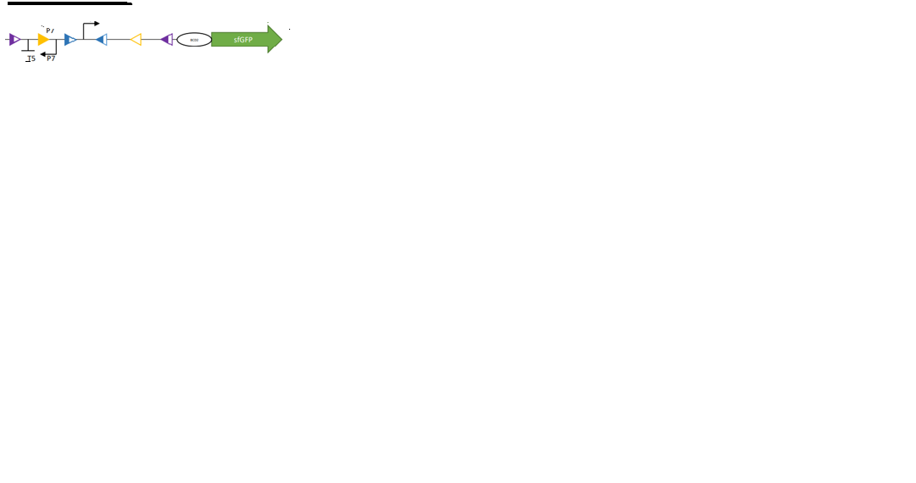
Explanation for the limit
Could it be a problem with the sequence?
Is P6 a weak promoter?
Adding layers of complexity

Slide 32
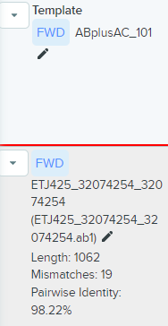
Adding layers of complexity

Slide 33
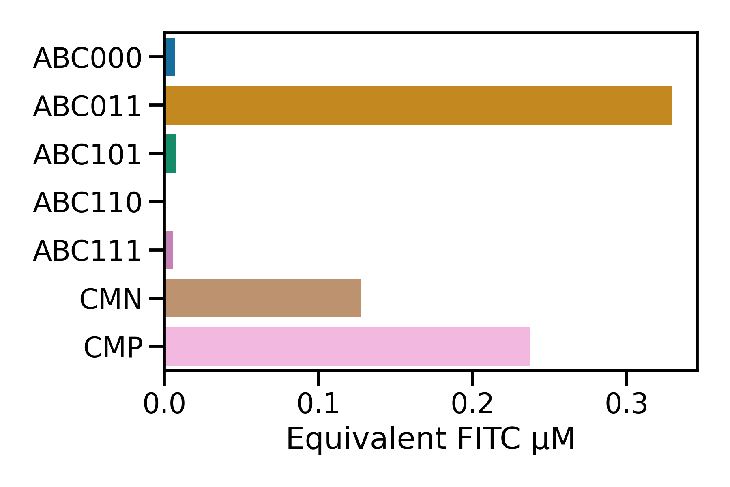
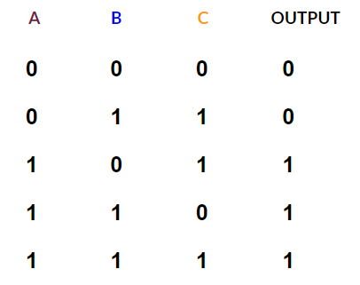
Adding layers of complexity

Slide 34
NAND
BXB1
TP901
OUTPUT
0 | 0 | 0
0 | 1 | 0
1 | 0 | 0
1 | 1 | 1
Adding layers of complexity

Slide 35
NOT
BXB1
TP901
OUTPUT
0 | 0 | 1
0 | 1 | 1
1 | 0 | 1
1 | 1 | 0
Adding layers of complexity

Slide 36
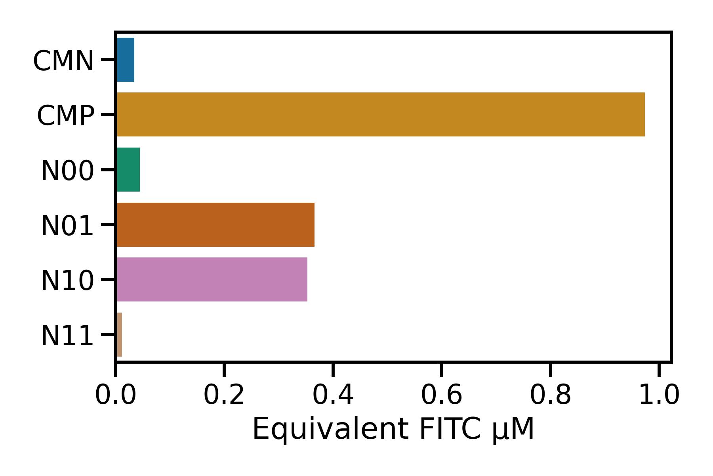
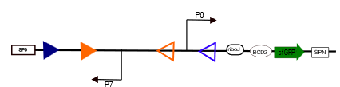
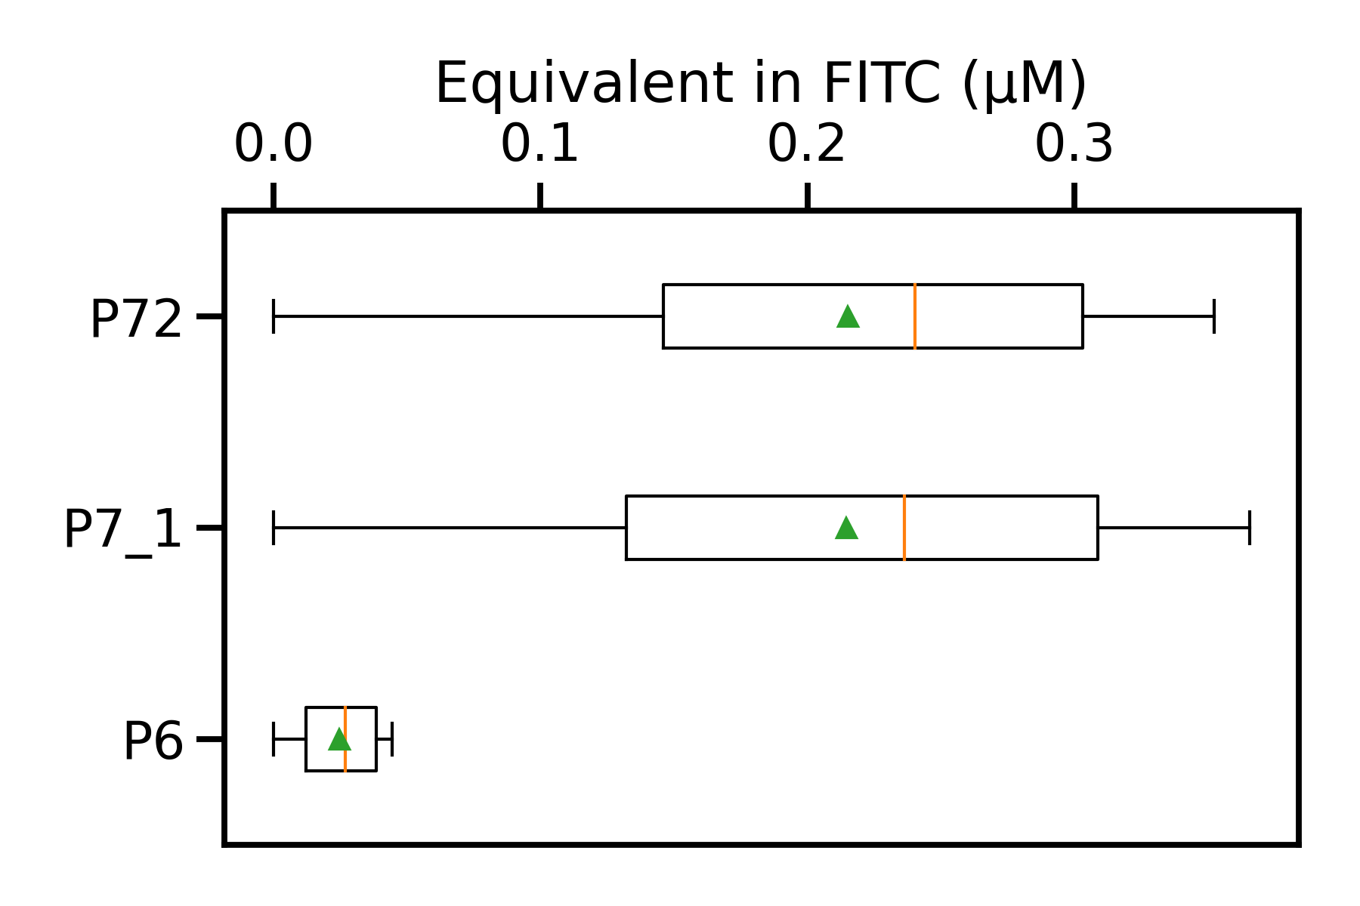
is P6 a weak promoter?
Adding layers of complexity

Slide 37
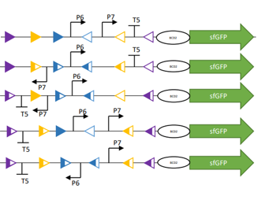
Limits of the system
A
B
C
OUTPUT
0 | 0 | 0 | 0
0 | 1 | 1 | 0
1 | 0 | 1 | 1
1 | 1 | 0 | 1
1 | 1 | 1 | 1
Adding layers of complexity

Slide 38
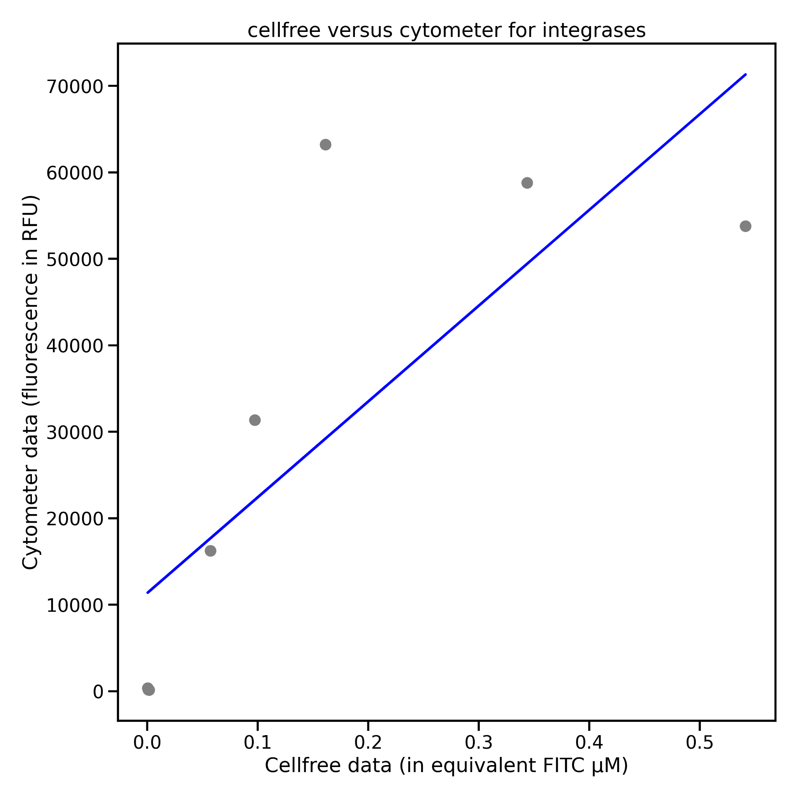
First try with simple linear regression
Slope: 0.000006
Intercept: -0.006
Mean squared error: 0.013
Coefficient of determination (r²) : 0.620
F value: 9.8
P-value: 2.03e-02
r² not very good -> presence of an outlier ( 0.2, 65000 )
Correlation cyto/CF

Slide 39
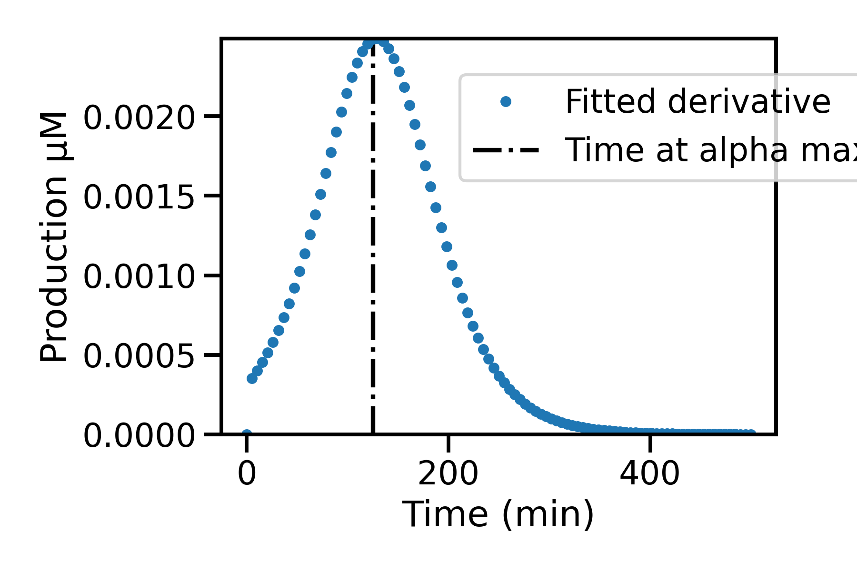
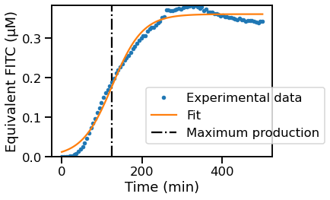
Modeling

Slide 40
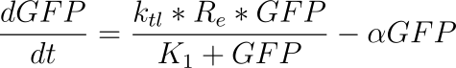
Presumed constant
k1
ktl
DNA RNA PROTEIN
k2
ktl : translation rate : µM*min-1
Re : resource factor : µM
K1: michaelis menten constant (k1/k2) : µM
𝛼 : maturation rate: min-1
Inspired from Stögbauer et al. Integrative Biology 2012
Modeling

Slide 41
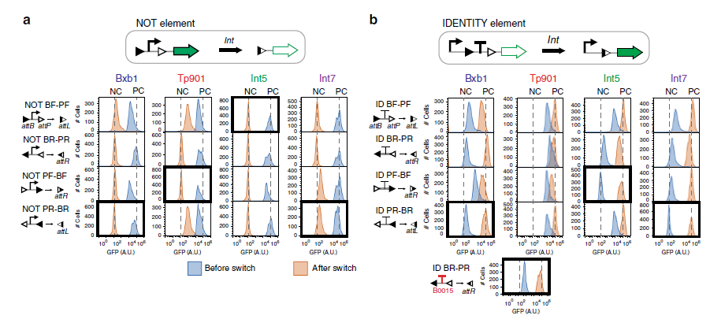
S.Guiziou et al, nature communications 2019
Correlation cyto/CF

Slide 42
Discussion

Slide 43
Modeling

